Slide 1
MSE – 803 – Data Analytics
Week 1 – Activity 2
Housing Prices
Andre Benedetti
17/04/2026

Slide 2
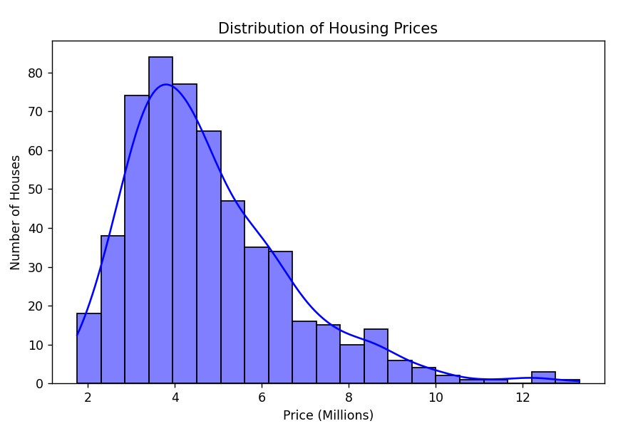
Housing Prices - Overview
Houses | 545
max Price | 13,300,000
min Price | 1,750,000
avg Price | 4,766,000
max Area | 16,200
min Area | 1,650
avg Area | 5,150

Slide 3
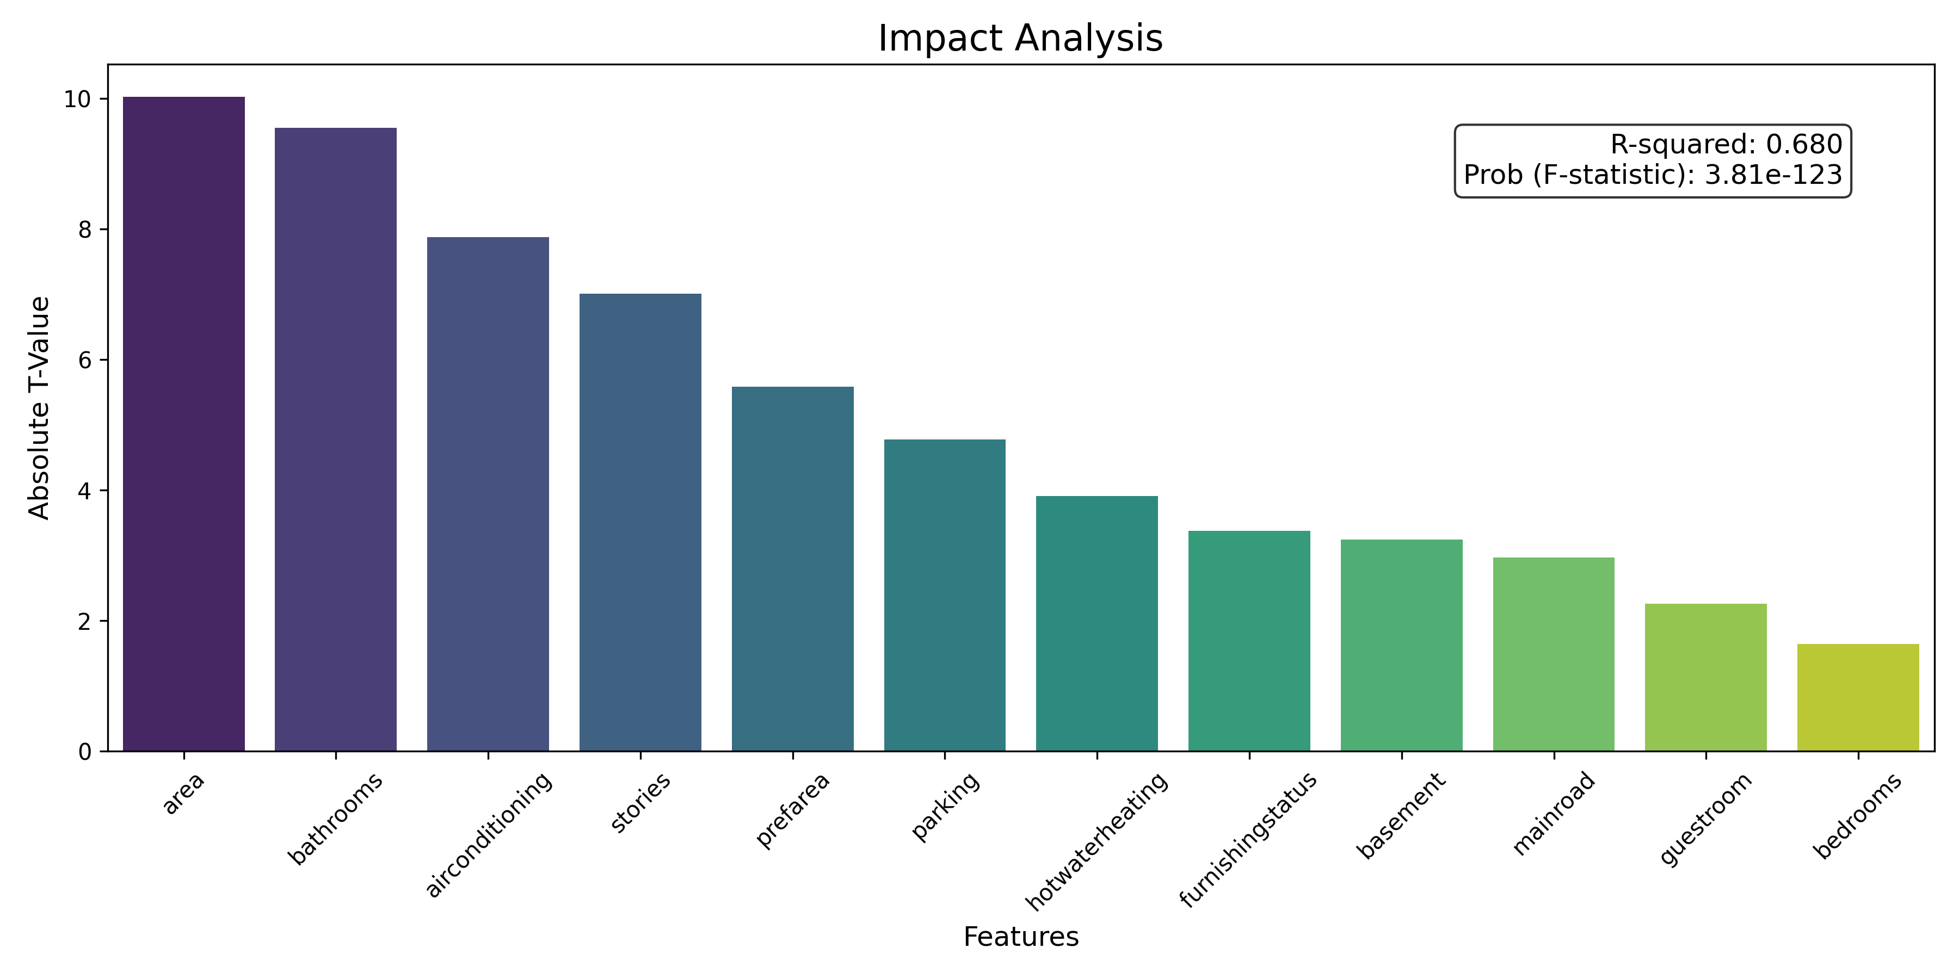
Housing Prices – Features

Slide 4
Housing Prices – Construction Features
Feature | Aditional Price
Bathrooms | $ 988,888
Stories | $ 450,392
Basement | $ 357,926
Feature | % | Avg Price
1 Bathroom | 73.6% | $ 4,206,912.72
2 Bathrooms | 24.4% | $ 6,209,206.32
3 Bathrooms | 1.8% | $ 7,282,100.00
4 Bathrooms | 0.2% | $ 12,250,000.00
1 Stories | 41.7% | $ 4,170,658.59
2 Stories | 43.7% | $ 4,764,073.53
3 Stories | 7.2% | $ 5,685,435.90
4 Stories | 7.5% | $ 7,208,449.76
With Basement | 65% | $ 4,509,965.93
Without Basement | 35% | $ 5,242,615.18

Slide 5
Housing Prices – Amenities Features
Feature | Aditional Price
Hot Water Heating | $ 872,936
Air Conditioning | $ 853,634
Pref. Area | $ 647,056
Feature | % | Avg Price
Without Air Conditioning | 68% | $ 4,191,939.68
With Air Conditioning | 32% | $ 6,013,220.58
Without Hot Water Heating | 95% | $ 4,728,593.15
With Hot Water Heating | 5% | $ 5,559,960.00
Not in a Pref. Area | 77% | $ 4,425,298.78
In a Pref. Area | 23% | $ 5,879,045.70

